Slide 1

WarZone BUILD 3 (TEAM U7) SOEN 6441 Fall 2023 Submitted to: Dr. Amin Ranj Bar
40261785 – ABHISHEKKUmar MAVANI 40231114 - SHREY Agrawal
40226105 - AKSHARKUMAR PATEL 40274495 - SHUBH thummar
40230415 - KARNIK SHAH 40265305 - UMANG savlA

Slide 2
FLOW OF THE PRESENTATION
1. Architectural design of the Project.
2. Demonstration of functional requirements.
3. Coding Conventions and tools used.
4. Discussion of Refactoring document.

Slide 3
ARCHITECTURAL DESIGN
CONTROLLER
GameEngine
MapController
PlayerController
Phase
Action
MODEL
Update
CONTROLLR
USER
Execute
Order
Startup
IssueOrder
End
Edit
CONTROLLER
Reinforcement
Feedback
VIEW
MODEL
Order
CommandPrompt
Feedback
GameModel
Map
Continent
Country
Player
Order
CONTROLLR
Blockade
Airlift
Bomb
CONTROLLER
Advance
Deploy
Negotiate
VIEW
MODEL – VIEW – CONTROLLER ARCHITECTURE

Slide 4
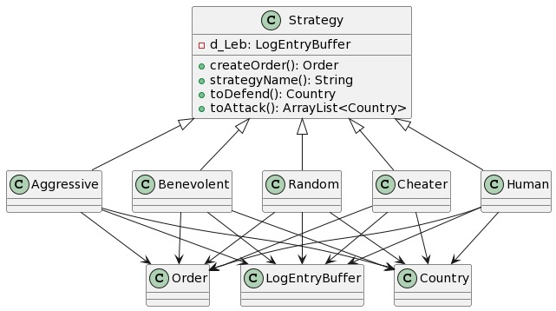
Strategy Pattern
GameEngine
VIEW
Adaptor
loadMap()
SaveMap()
Adaptee
loadConquestMap()
saveConquestmap()

Slide 5
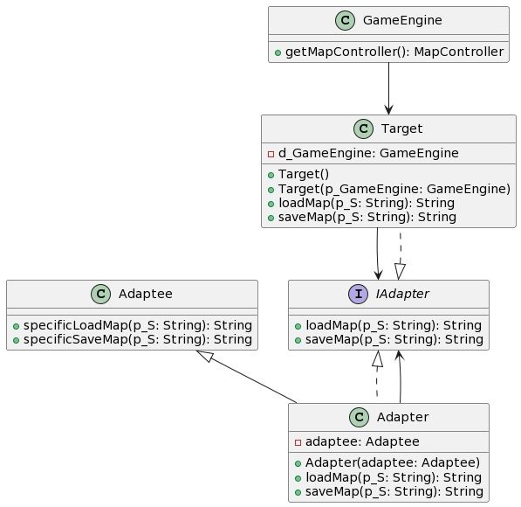
Adapter Pattern
GameEngine
VIEW
Adaptor
loadMap()
SaveMap()
Adaptee
loadConquestMap()
saveConquestmap()

Slide 6
CODING CONVENTIONS AND TOOLS USED
Class names in CamelCase that starts with a capital letter.
Data members start with d_ .
Method parameters start with p_ .
Local variables start with l_ .
Static members start with a capital letter, non-static members start with a lower case letter.
For version control we have used EGit (Eclipse Git) and Github.
For documentation we have used Javadoc.
For unit testing we have used JUnit.
For Continuous Integration we have used Github Actions.

